Slide 1
URDU IMAGE CAPTIONING WITH ATTENTION
Deep Learning Project – Group 1

Slide 2
GROUP MEMBERS
Mohammad Awais ( 242554 )

Slide 3





INTRODUCTION
Deep learning, advanced and natural part of life.

Slide 4
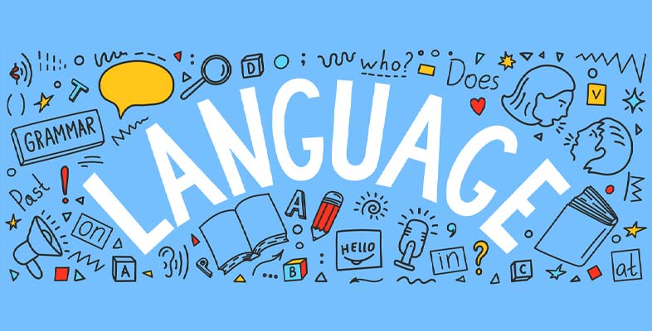
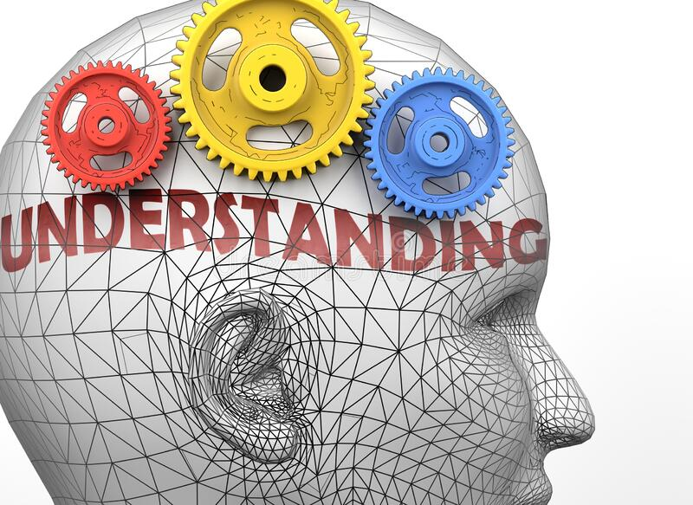
INTRODUCTION
Similarly, an application of deep learning known as Image Captioning.
Deals with image understanding (CV)and language description (NLP) for the image.

Slide 5
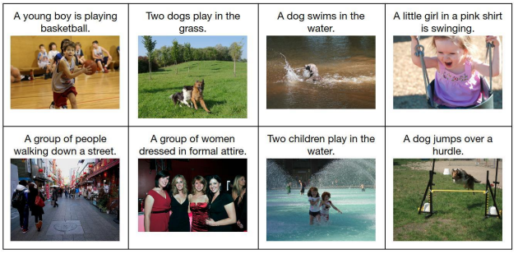
INTRODUCTION
Few results are like:

Slide 6
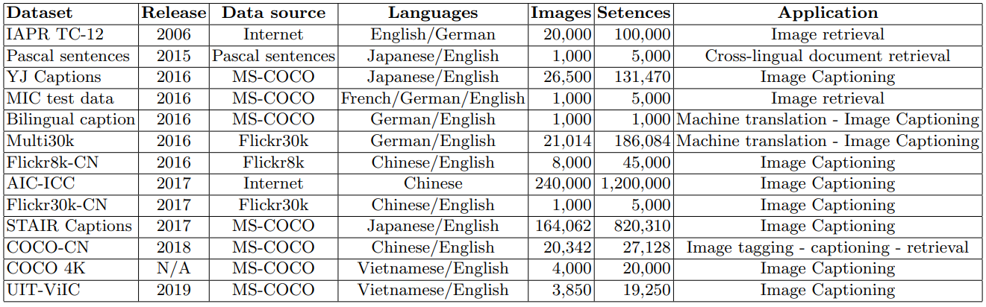
PROBLEM STATEMENT
Image Captioning datasets exists like:
Image Captioning in Urdu, possible?

Slide 7
AIM
Prepare Urdu image captioning dataset ( Local Language )
Build and Train Image Captioning model with Attention upon this dataset to generate Urdu Captions
Understanding the Image Captioning Model, Attention mechanism and necessary preparations for this task of a dataset in any language.

Slide 8
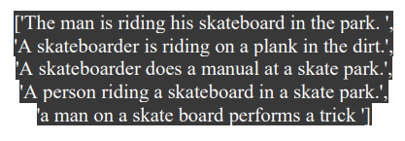
DATASET - intro
MS-COCO dataset, over 82,000 images with 5 Cap. Per each IMG.
For our model, we used 6000 images => 30k approx. captions.

Slide 9

DATASET - preparation and preprocessing
English -> Urdu ( Google Translate API , i.e. googletrans)
Standardized (removed special characters)
Added <start> & <end> tokens.
Created two lists of “image_path” & “urdu_caption” with corresponding indices.

Slide 10
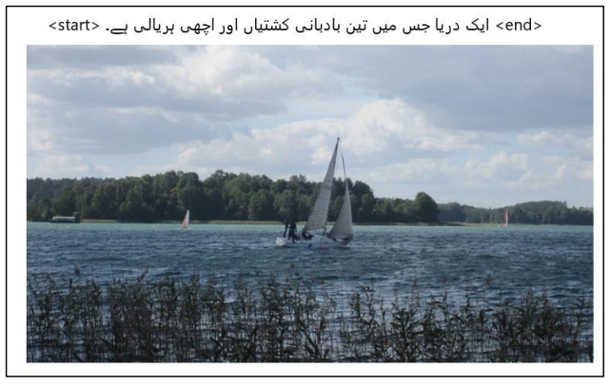
DATASET – sample

Slide 11
ARCHITECTURE
Image caption, automatically generating natural language descriptions according to the content observed in an image.
Generating well-formed sentences requires both syntactic and semantic understanding of the language

Slide 12
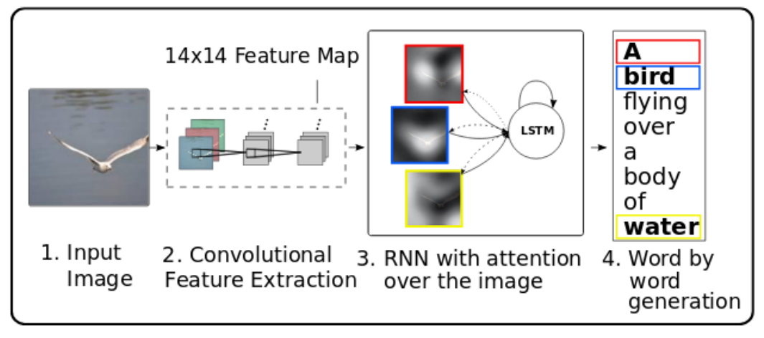
ARCHITECTURE

Slide 13
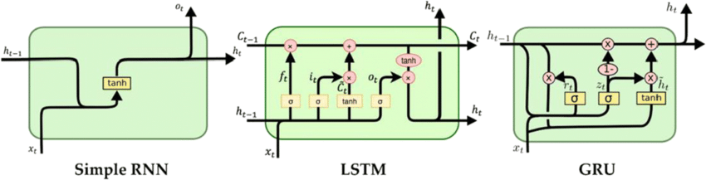
ARCHITECTURE
For this, we used following:
Inception v3 (pretrained on ImageNet) – Computer Vision
Gated Recurrent Unit (GRU) – Natural Language Processing

Slide 14
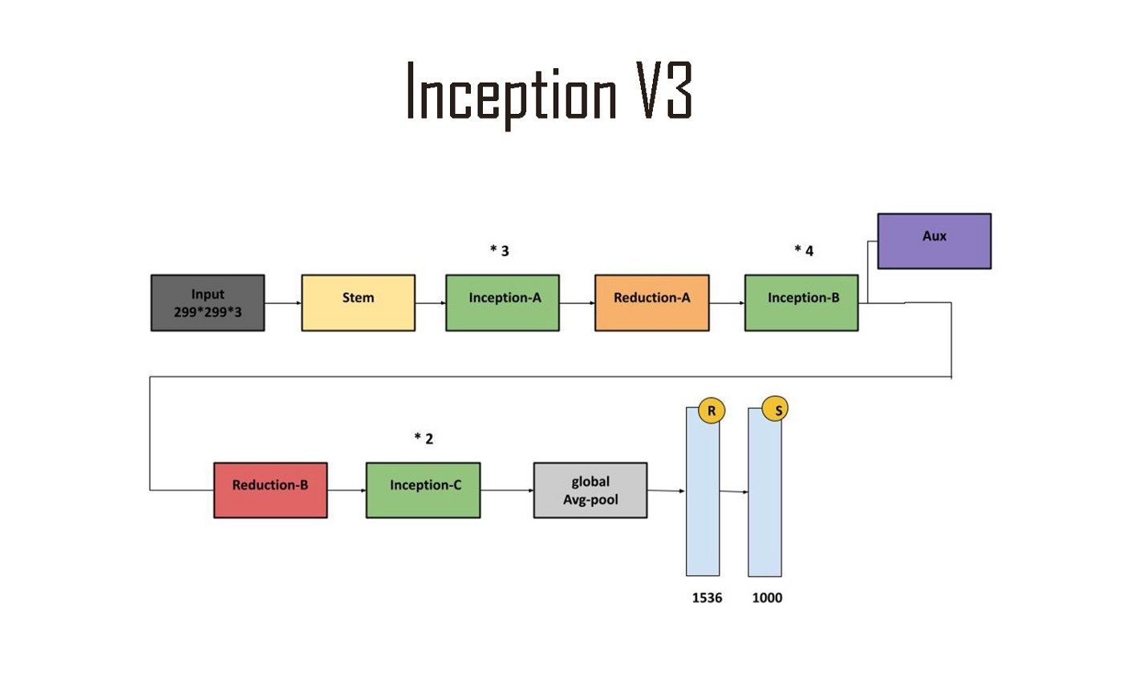
ARCHITECTURE

Slide 15
PROCEDURE
Step-1:
Images into Inceptionv3 format
299x299
Normalization to (-1 , 1)
Images as input, features from last conv. Layers
Step-2:
Tokenize Urdu words
Grammar from top 500 frequent words
Caption limit : 50 words
Word to Index & Index to Word mappings
Splitting 30k captioned data, 80% Training & 20% Testing

Slide 16
PROCEDURE
Step-3:
Feature vector (8,8,2048) -> (64,2048) shape
Passed into Encoder ( Single Fully Connected Layer)
Step-4:
Save features, encoder output which is obtained by passing images
Save Urdu Captions as NumPy list as well.

Slide 17
PROCEDURE
Bahdanau Attention:
Subsets of variable encodings instead of fixed length
Features and hidden with time axists -> Attention Hidden Layer
Score is obtained by Dense(1) layer whih upon Softmax gave attention weights.
Attention weights with features gave context_vextor.

Slide 18
PROCEDURE
Training:
Encoder output, hidden ( initialized to 0) and decoder input ( first word <start> is passed to decoder )
Decoder returns predictions (used to calc. loss) and then again are passed back into model ,i.e. Teacher Forcing
Final steps included gradients and optimizers to back propagate.

Slide 19
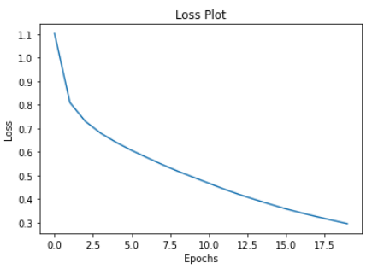
RESULTS
Model trained up to 20 Epochs in batch sizes of 64, took 1.5 hours overall.

Slide 20
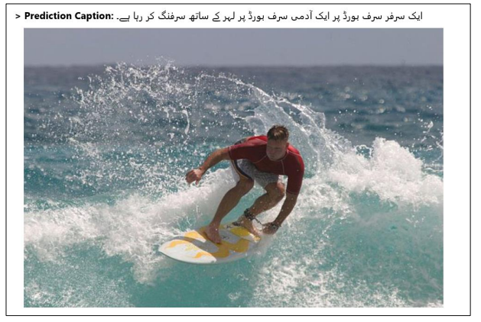
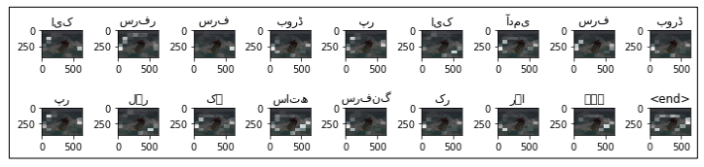
RESULTS

Slide 21
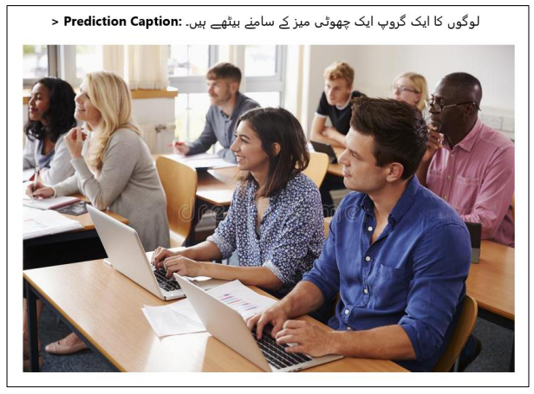
MORE CAPTIONING

Slide 22
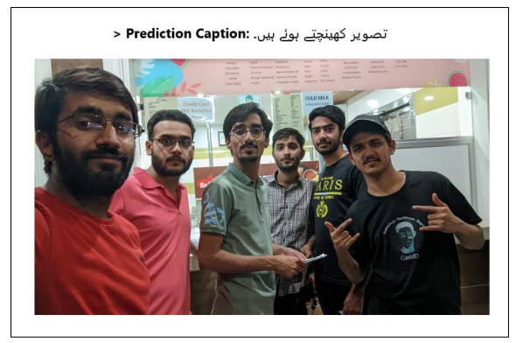
MORE CAPTIONING

Slide 23
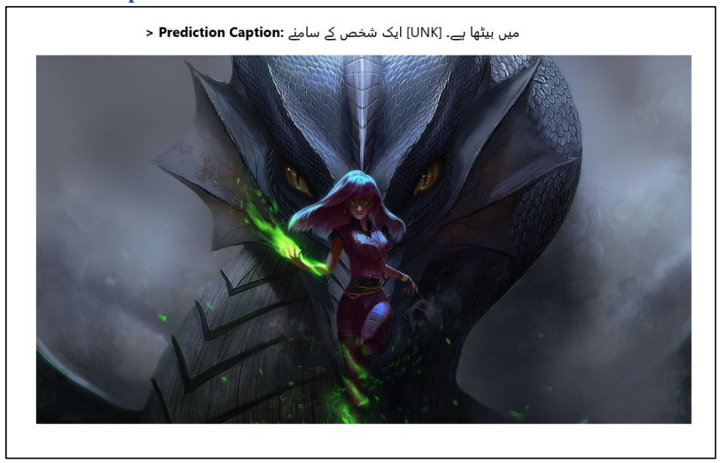
MORE CAPTIONING

Slide 24
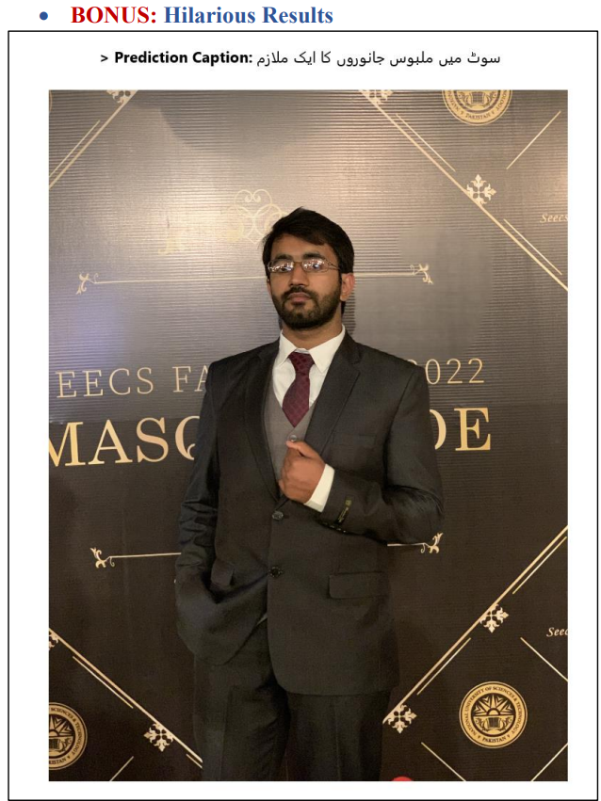
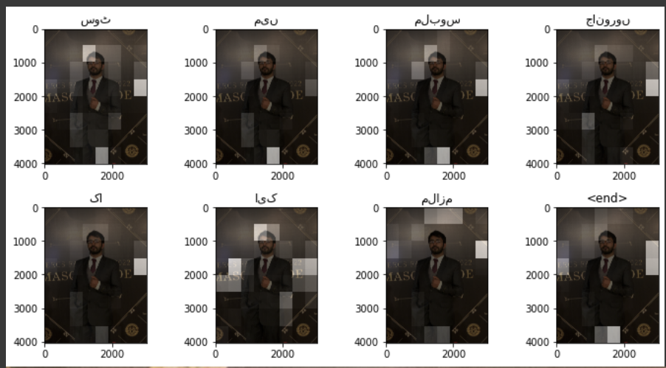
MORE CAPTIONING

Slide 25
CONCLUSION
Model did adapt the grammar and performed as best as it could in less data and samples.
Captions weren’t accurately but the context was identified when reading them unlike some:
Unknown, missing and simple words
Less exposure of images
Needless Long Captions

Slide 26
CONCLUSION
Deduced reasons:
Google Translations are not great Grammarly / Contextually for all languages in all cases
Less Exposure of Images (6k) out of which 80% used to train.
Long Captions is probably because the next word doesn’t give attention to past predictions

Slide 27
FUTURE WORKS
Phase-1
Increase dataset of images-captions, also include images of various kinds
Make this a “Self Attentive Urdu Image Captioning Model”, apply attention at Decoder side as well.
Phase-2
Creating good “Image-Urdu Captions” dataset.
Vague approach of using GAN Models with English-Image dataset to train GAN to generate image.
Use Translation dataset English-Urdu such that create images using GAN by putting English sentences and pairing the Images generated with their respective Urdu Sentences. i.e. More Better Urdu Image Captioning Dataset.

Slide 28
THANK YOU

